Slide 1

AI Smart Emergency Response System
TEAM MEMBERS
K.KALYANI AP23110011343
K.TEJA SREE AP23110011434
G.YAMINI AP23110011448
G.MOHANA KRISHNA AP23110011462
R.LOHITHA AP23110011469

Slide 2
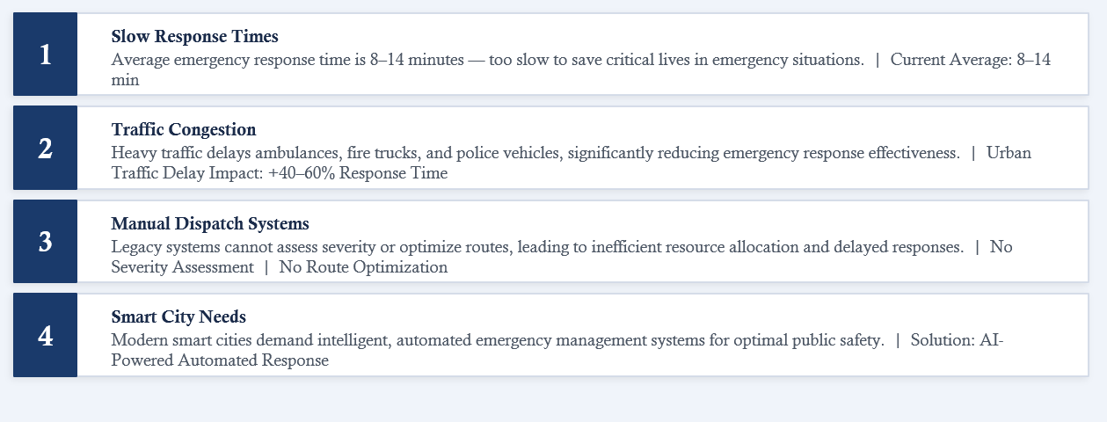
Current System Limitations

Slide 3
Our Approach
Solution Overview
Tech Stack
Our Solution
A comprehensive AI-powered emergency dispatch system that revolutionizes emergency response through intelligent automation.
Python
Scikit-learn
Core programming language for backend logic, data processing, and model integration.
Machine learning library for training and deploying the Random Forest severity model.
Machine Learning
Severity prediction using Random Forest for intelligent triage and resource allocation.
TensorFlow/Keras
OSMnx/NetworkX
Deep learning framework for building and training the LSTM traffic prediction network.
Real-world road network analysis and shortest path computation for route optimization.
Deep Learning
LSTM neural networks analyze temporal traffic patterns for real-time congestion prediction.
Streamlit
Geopy/Folium
Real-time GPS Routing
Interactive web dashboard for real-time emergency monitoring and system visualization.
Geocoding services and interactive map visualization for live route tracking.
Optimal route calculation using OpenStreetMap data and Dijkstra's algorithm.

Slide 4
How It Works
User SOS
Input
Location
Detection
Traffic Prediction
(LSTM)
Severity Prediction
(Random Forest)
Vehicle
Dispatch
Route
Optimization
Live Map
Tracking
1. SOS Trigger
2. Geolocation
3. AI Analysis
User initiates emergency via Streamlit interface with location and emergency type.
System extracts GPS coordinates and maps to nearest road network node.
LSTM predicts traffic congestion; Random Forest assesses emergency severity.
4. Smart Dispatch
5. Path Finding
6. Live Tracking
AI agent selects optimal vehicle based on severity, traffic, and proximity.
Dijkstra's algorithm computes shortest path avoiding congested road segments.
Real-time GPS simulation shows vehicle progress on interactive Folium map.

Slide 5
Machine Learning
Severity Prediction (ML)
Random Forest Regressor
Critical Threshold
Input Features
85+
Traffic congestion level, emergency type, time of day, location data from dataset.csv
Severity Score
Triggers immediate dispatch of ICU Emergency Unit
Output
Severity score ranging from 0 to 100
Model Characteristics
Model Performance
Fast training and prediction, interpretable feature importance, robust to overfitting.
Fast
High
Prediction Speed
Accuracy
Training Data
Emergency response dataset ( dataset.csv ) with historical incident records.
Interpretable predictions with feature importance analysis

Slide 6
Deep Learning
Traffic Prediction (DL)
Training Configuration
LSTM Neural Network
50
MSE
Architecture
Epochs Trained
Loss Function
Long Short-Term Memory network built with Keras/TensorFlow for sequential data processing.
Adam
High
Input Sequence
Optimizer
Accuracy
Time-series data: [time, day, weather] — learns temporal traffic patterns.
Key Advantage
Output
Real-time traffic congestion score (0-100) for route optimization.
LSTM networks excel at learning long-term temporal dependencies in sequential traffic data.
Model Persistence
Captures rush hour and weekend patterns
Trained model saved as traffic_dl.h5
Adapts to weather conditions
Real-time inference in milliseconds

Slide 7
Intelligent Agent
Smart Vehicle Dispatch
ICU Emergency Unit
Ambulance
Critical Response
Medical Emergency
Severity > 85 AND Traffic > 70
Emergency Type = Medical
Highest priority dispatch
Injury
Illness
Accident
Specialized ICU vehicle with advanced life support equipment for critical emergencies.
Standard ambulance dispatch for non-critical medical emergencies and patient transport.
Fire Truck
Police Vehicle
Fire Emergency
Law Enforcement
Emergency Type = Fire
Emergency Type = Police
Building Fire
Vehicle Fire
Crime
Accident
Security
Fire suppression vehicle with water tank, hoses, and rescue equipment for fire incidents.
Police patrol vehicle for law enforcement, accident response, and public safety incidents.

Slide 8
Navigation System
Map-Based Optimal Routing
OSMnx
Folium
Downloads real-world road network from OpenStreetMap with accurate street geometries, speed limits, and traffic data.
Renders live interactive map with route animation, SOS markers, hospital locations, and vehicle tracking.
GPS Simulation
NetworkX
Ambulance moves step-by-step on the calculated route from dispatch location to SOS destination with real-time position updates.
Computes shortest path using Dijkstra's algorithm, optimizing for distance and traffic conditions.
Live Vehicle Tracking
Step-by-step GPS animation

Slide 9
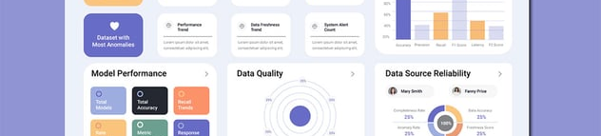
User Interface
Live Emergency Dashboard
Live Folium Map
Sidebar Controls
Enter Location — GPS coordinates or address
Select Emergency Type — Medical, Fire, Police
SOS Button — Trigger emergency dispatch
Optimized Route — Shortest path visualization
Moving Ambulance — Real-time GPS tracking
SOS Marker — Emergency location
Hospital Marker — Nearest medical facility
Dashboard Metrics
Progress Tracking
Vehicle Assigned
Traffic Level
Ambulance
Moderate
Real-time progress bar showing vehicle en route with stage indicators:
Dispatch Progress
65%
Severity Score
ETA
78/100
4.2 min
Dispatched
En Route
Arrived

Slide 10
Performance Metrics
System Performance Highlights
Response Time
~2 sec
Road Network
Real Data
Time to predict traffic + assess severity + assign vehicle and calculate optimal route
Routing via actual OpenStreetMap data with real road geometries, speed limits, and traffic patterns
Traditional System
8-14 min
100%
Live
Our AI System
~2 sec
Real Roads
Traffic Data
AI Models Working Together
Emergency Types Supported
2 Models
3 Types
Random Forest
LSTM
Medical
Fire
Police
Severity Prediction
Traffic Prediction

Slide 11
Roadmap
What's Next?
1
Real-time IoT Sensor Integration
Integrate IoT traffic sensors and cameras for live traffic feeds, providing real-time congestion data for more accurate predictions.
GPS Tracking of Emergency Vehicles
2
Deploy GPS trackers on actual emergency vehicles for real-time location monitoring and dynamic route adjustments.
3
Reinforcement Learning Optimization
Implement reinforcement learning for adaptive dispatch optimization, learning from historical response data to improve decisions.
4
Mobile SOS App
Develop mobile application with one-tap emergency trigger, GPS auto-detection, and push notifications for status updates.
Multi-City Smart City Integration
5
Scale system for multi-city deployment with centralized monitoring, cross-city resource coordination, and unified emergency response network.

Slide 12
Thank You

